Slide 1

Breast Cancer Detection Using CNN

Slide 2
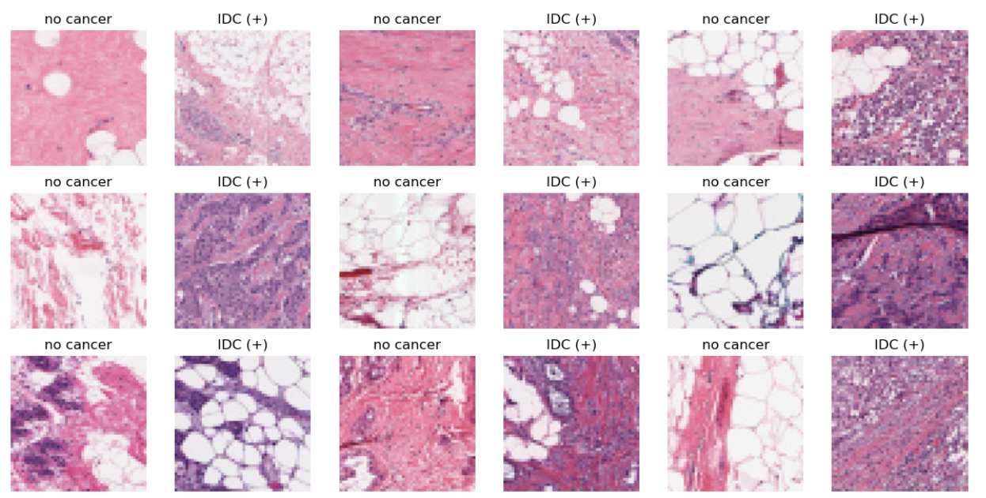
Data set with cancer

Slide 3
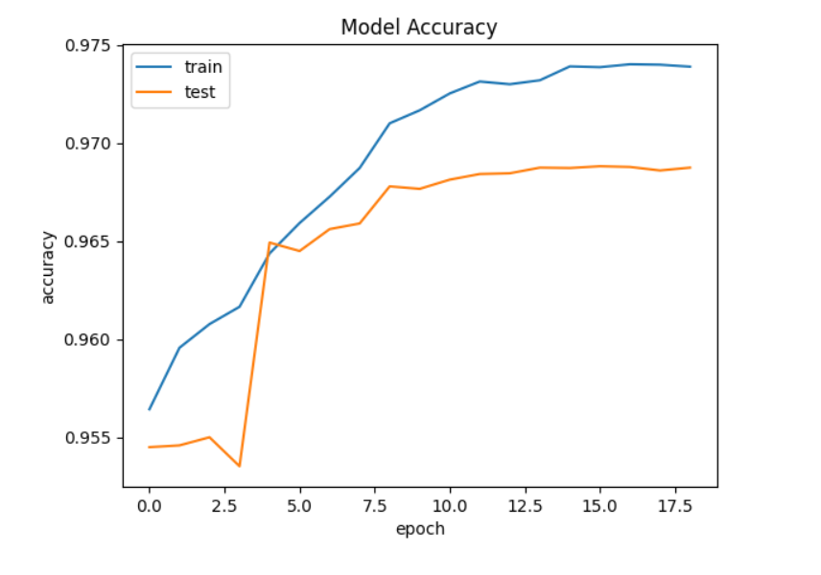
Model Accuracy using CNN

Slide 4
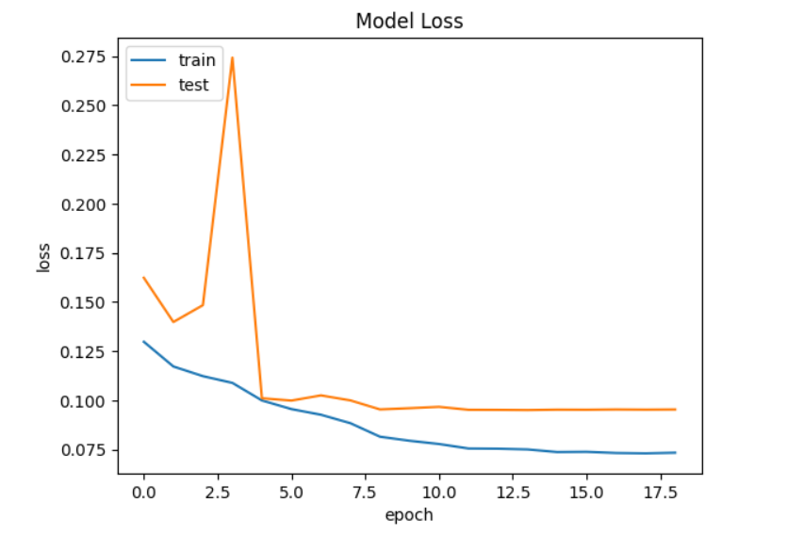
Model Validation loss using CNN

